Slide 1
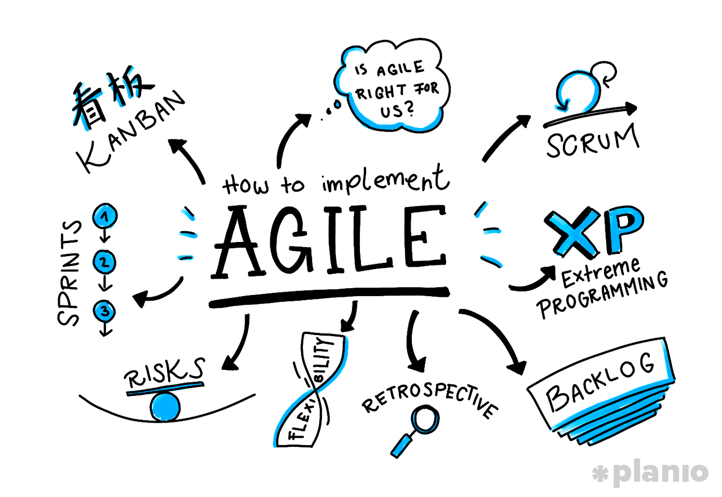

AGILE
MANIFESTO
Group 4 – SWT301
Nguyen
Tran Phong
Vo Van
Thanh Phuc
Mai
Thanh Hoang
Tran
Tan Long

Slide 2
CONTENTS
1
What is Agile?
Why Agile?
2
3
4 Values of Agile Manifesto
12 Principles of Agile Manifesto
4

Slide 3

1. What is Agile?

Slide 4


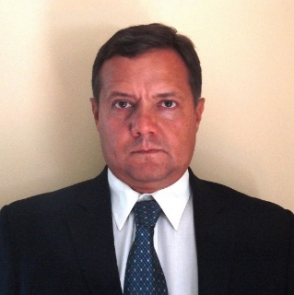

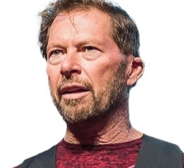
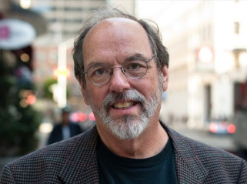
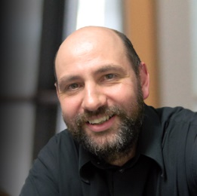





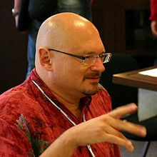
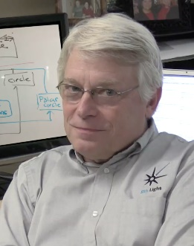

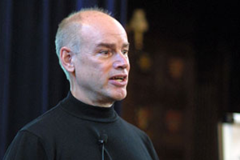
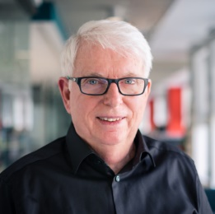
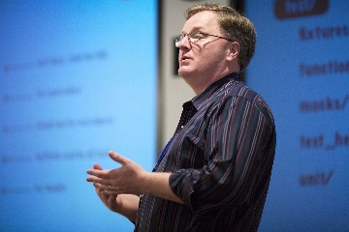
1. What is Agile?
Snowbird, Utah, USA
February, 2001
Alistair Cockburn
Ward Cunningham
THE AGILE
MANIFESTO
Kent Beck
Mike Beedle
Arie van Bennekum
Martin Fowler
James Grenning
Jim Highsmith
Andrew Hunt
Ron Jeffries
Jon Kern
Brian Marick
4 Values & 12 Principles
Robert C. Martin
Steve Mellor
Ken Schwaber
Jeff Sutherland
Dave Thomas

Slide 5
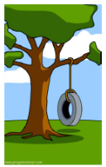
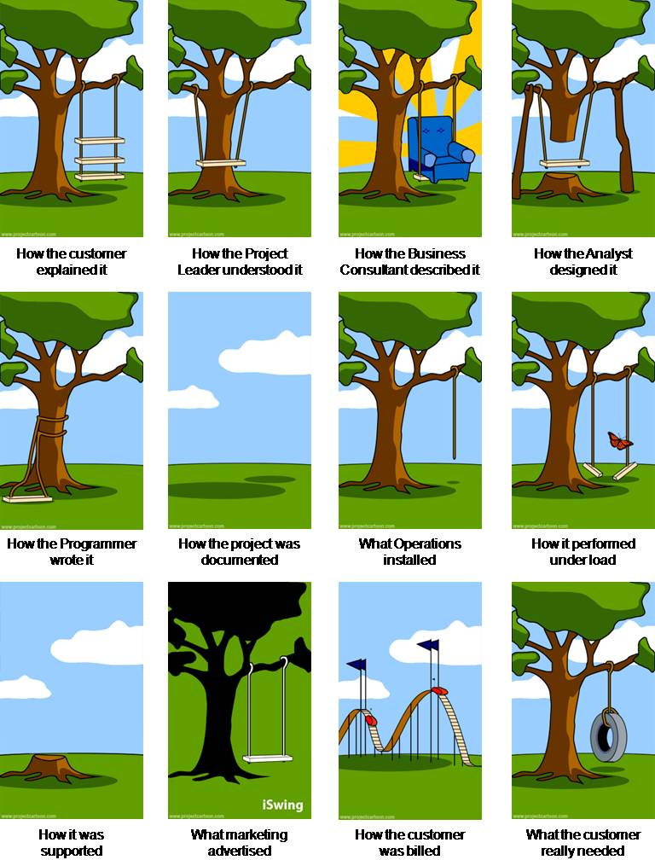
2. Why Agile?
Challenges with Waterfall Method
WHAT THE CUSTOMER
REALLY WANTED
HOW THE CUSTOMER
EXPLAINED IT
Requirements
HOW THE ANALYST
DESIGNED IT
Design
HOW THE PROGRAMMER
WROTE IT
Implementation
Testing
Deployment
Operation and Maintenance

Slide 6
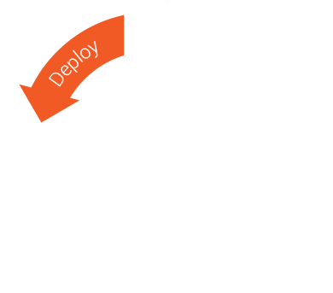
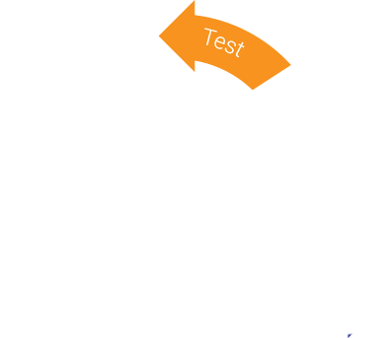

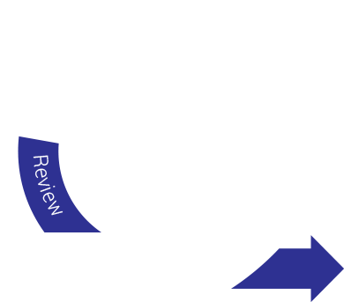

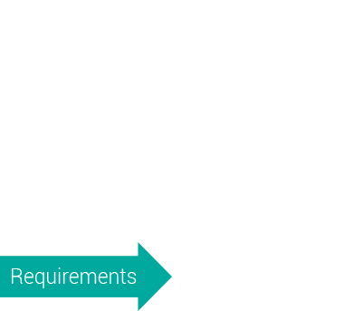
2. Why Agile?
Agile Model
AGILE

Slide 7


3. 4 Values of Agile Manifesto
Individuals and interactions
OVER
Processes and tools

Slide 8


3. 4 Values of Agile Manifesto
Comprehensive
documentation
Working software
OVER

Slide 9


3. 4 Values of Agile Manifesto
Contract negotiation
Customer collaboration
OVER

Slide 10


3. 4 Values of Agile Manifesto
Following a plan
Responding to change
OVER

Slide 11

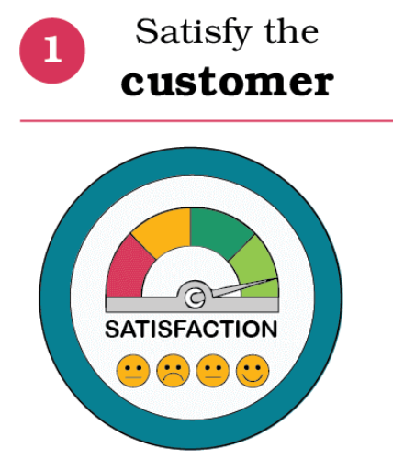
4. 12 Principles of Agile Manifesto
Our highest priority is to satisfy the customers through early and continuous delivery of valuable software.

Slide 12

4. 12 Principles of Agile Manifesto
Welcome changing requirements, even late in development. Agile processes harness change for the customer’s competitive advantage.

Slide 13
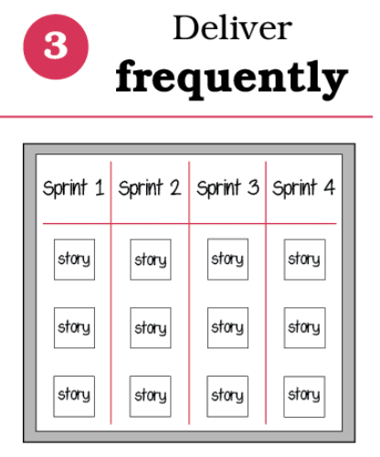
4. 12 Principles of Agile Manifesto
Deliver working software frequently, from a couple of weeks to a couple of months, with a preference to the shorter timescale.

Slide 14

4. 12 Principles of Agile Manifesto
Business people and developers must work together daily throughout the project.

Slide 15

4. 12 Principles of Agile Manifesto
Build projects around motivated individuals. Give them the environment and support they need, and trust them to get the job done.

Slide 16

4. 12 Principles of Agile Manifesto
The most effective and effective method of conveying information to and within a development team is face-to-face conversation.

Slide 17
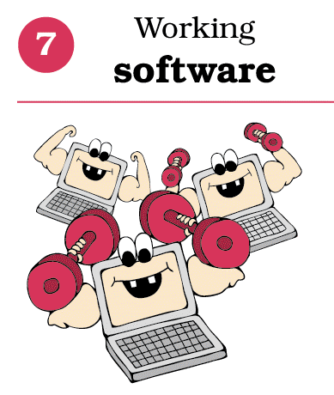
4. 12 Principles of Agile Manifesto
Working software is the primary measure of progress.

Slide 18
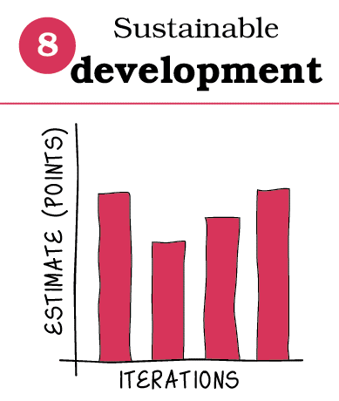
4. 12 Principles of Agile Manifesto
Agile processes promote sustainable development. The sponsors, developers, and users should be able to maintain a constant pace indefinitely.

Slide 19
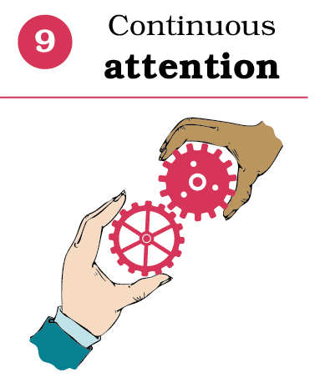
4. 12 Principles of Agile Manifesto
Continuous attention to technical excellence and good design enhances agility.

Slide 20

4. 12 Principles of Agile Manifesto
Simplicity -- the art of maximizing the amount of work not done -- is essential.

Slide 21

4. 12 Principles of Agile Manifesto
The best architectures, requirements, and designs emerge from self-organizing teams.

Slide 22
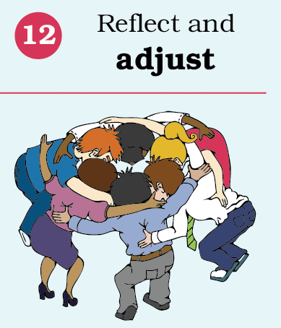
4. 12 Principles of Agile Manifesto
At regular intervals, the team reflects on how to become more effective, the tunes and adjusts its behavior accordingly.

Slide 23
References
https://agilemanifesto.org/
https://fatinsl.info/
https://itmscoaching.com/quy-trinh-phat-trien-phan-mem/
https://www.knowledgetrain.co.uk/agile/agile-principles
https://www.youtube.com/watch?v=rf8Gi2RLKWQ
https://www.youtube.com/watch?v=5jCc2KByx60
https://www.coursera.org/learn/agile-software-development/lecture/aNH2E/why-agile

Slide 24


